Slide 1
Recurrences and Running Time
An equation or inequality that describes a function in terms of its value on smaller inputs.
T(n) = T(n-1) + n
Recurrences arise when an algorithm contains recursive calls to itself
What is the actual running time of the algorithm?
Need to solve the recurrence
  Find an explicit formula of the expression
  Bound the recurrence by an expression that involves n

Slide 2
Example Recurrences
T(n) = T(n-1) + n Θ(n²)
  Recursive algorithm that loops through the input to eliminate one item
T(n) = T(n/2) + c Θ(lgn)
  Recursive algorithm that halves the input in one step
T(n) = T(n/2) + n Θ(n)
  Recursive algorithm that halves the input but must examine every item in the input
T(n) = 2T(n/2) + 1 Θ(n)
  Recursive algorithm that splits the input into 2 halves and does a constant amount of other work

Slide 3
Recursive Algorithms BINARY-SEARCH
for an ordered array A, finds if x is in the array A[lo…hi]
Alg.: BINARY-SEARCH (A, lo, hi, x)
if (lo > hi)
return FALSE
mid ← ⎣(lo+hi)/2⎦
if x = A[mid]
return TRUE
if ( x < A[mid] )
BINARY-SEARCH (A, lo, mid-1, x)
if ( x > A[mid] )
BINARY-SEARCH (A, mid+1, hi, x)
1
2
3
4
5
6
7
8
2
3
5
7
9
10
11
12
mid
lo
hi

Slide 4
Example
A[8] = {1, 2, 3, 4, 5, 7, 9, 11}
  lo = 1 hi = 8 x = 7
1
2
3
4
5
6
7
8
1
2
3
4
5
7
9
11
mid = 4, lo = 5, hi = 8
5
6
7
8
1
2
3
4
5
7
9
11
mid = 6, A[mid] = x Found!

Slide 5
Another Example
A[8] = {1, 2, 3, 4, 5, 7, 9, 11}
  lo = 1 hi = 8 x = 6
1
2
3
4
5
6
7
8
1
2
3
4
5
7
9
11
mid = 4, lo = 5, hi = 8
low
high
1
2
3
4
5
7
9
11
mid = 6, A[6] = 7, lo = 5, hi = 5
low
high
1
2
3
4
5
7
9
11
mid = 5, A[5] = 5, lo = 6, hi = 5
NOT FOUND!
1
2
3
4
5
7
9
11
high
low

Slide 6
Analysis of BINARY-SEARCH
Alg.: BINARY-SEARCH (A, lo, hi, x)
if (lo > hi)
return FALSE
mid ← ⎣(lo+hi)/2⎦
if x = A[mid]
return TRUE
if ( x < A[mid] )
BINARY-SEARCH (A, lo, mid-1, x)
if ( x > A[mid] )
BINARY-SEARCH (A, mid+1, hi, x)
T(n) = c +
  T(n) – running time for an array of size n
constant time: c₁
constant time: c₂
constant time: c₃
same problem of size n/2
same problem of size n/2
T(n/2)

Slide 7
Quicksort Analysis
Assumptions:
  A random pivot (no median-of-three partitioning)
  No cutoff for small arrays
Running time
  pivot selection: constant time, i.e. O(1)
  partitioning: linear time, i.e. O(N)
  running time of the two recursive calls
T(N)=T(i)+T(N-i-1)+ N
  i➔ number of elements in left array S1
  The remaining N-1-i elements in right array

Slide 8
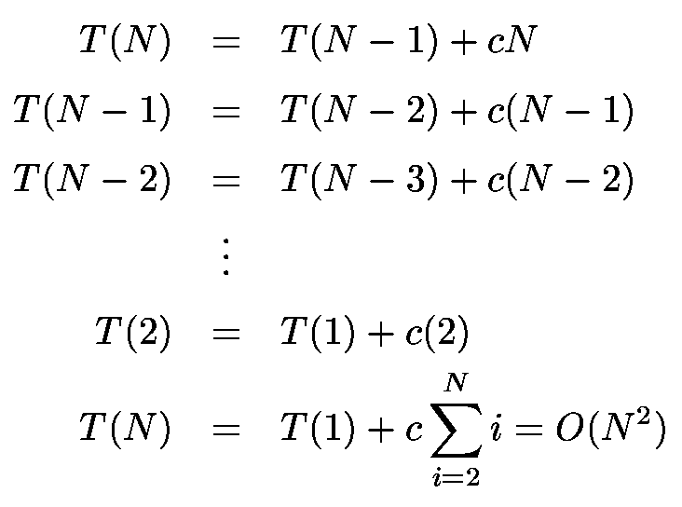
Worst-Case Analysis
What will be the worst case?
  The pivot is the smallest element, all the time
  Partition is always unbalanced
  That is left side contains no elements. So i=0.
  So in the recurrence T(N)=T(i)+T(N-1-i)+N substitute i=0.
  We get the recurrence T(N)=T(0)+T(N-1)+N. Solving yields O(n²)

Slide 9
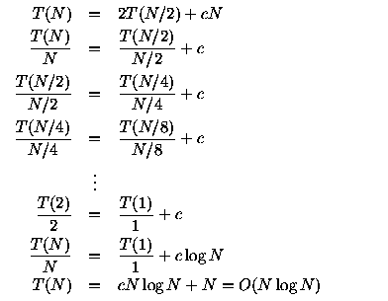
Best-case Analysis
What will be the best case?
  Partition is perfectly balanced.
  Pivot is always in the middle (median of the array)
  That is left side contains N/2 elements. So i=N/2.
  So in the recurrence T(N)=T(i)+T(N-1-i)+N substitute i=N/2
  We get the recurrence T(N)=T(N/2)+T(N/2)+N. Solving yields O(NLOGN)

Slide 10
Methods for Solving Recurrences
Iteration method
Substitution method
Recursion tree method
Master method

Slide 11
The Iteration Method
Convert the recurrence into a summation and try to bound it using known series
  Iterate the recurrence until the initial condition is reached.
  Use back-substitution to express the recurrence in terms of n and the initial (boundary) condition.

Slide 12
The Iteration Method
T(n) = c + T(n/2)
T(n) = c + T(n/2)
= c + c + T(n/4)
= c + c + c + T(n/8)
Assume n = 2^{k}
T(n) = c + c + … + c + T(1)
= clgn + T(1)
= Θ(lgn)
T(n/2) = c + T(n/4)
T(n/4) = c + T(n/8)
k times

Slide 13
Iteration Method – Example
T(n) = n + 2T(n/2)
T(n) = n + 2T(n/2)
= n + 2(n/2 + 2T(n/4))
= n + n + 4T(n/4)
= n + n + 4(n/4 + 2T(n/8))
= n + n + n + 8T(n/8)
… = in + 2^{i}T(n/2^{i})
= kn + 2^{k}T(1)
= nlgn + nT(1) = Θ(nlgn)
Assume: n = 2^{k}
T(n/2) = n/2 + 2T(n/4)

Slide 14

Changing variables
T(n) = 2T( ) + lgn
  Rename: m = lgn ⇒ n = 2^{m}
  T (2^{m}) = 2T(2^{m/2}) + m
  Rename: S(m) = T(2^{m})
  S(m) = 2S(m/2) + m ⇒ S(m) = O(mlgm) (demonstrated before)
  T(n) = T(2^{m}) = S(m) = O(mlgm)=O(lgnlglgn)
  Idea: transform the recurrence to one that you have seen before

Slide 15
The recursion-tree method
Convert the recurrence into a tree:
  Each node represents the cost incurred at various levels of recursion
  Sum up the costs of all levels
Used to “guess” a solution for the recurrence

Slide 16
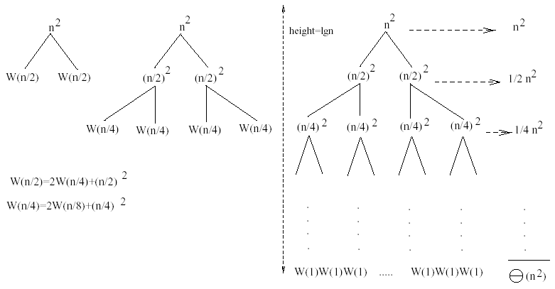
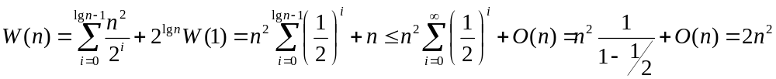
Example 1
W(n) = 2W(n/2) + n²
Subproblem size at level i is: n/2^{i}
Subproblem size hits 1 when 1 = n/2^{i} ⇒ i = lgn
Cost of the problem at level i = (n/2^{i})² No. of nodes at level i = 2^{i}
Total cost:
⇒ W(n) = O(n²)

Slide 17
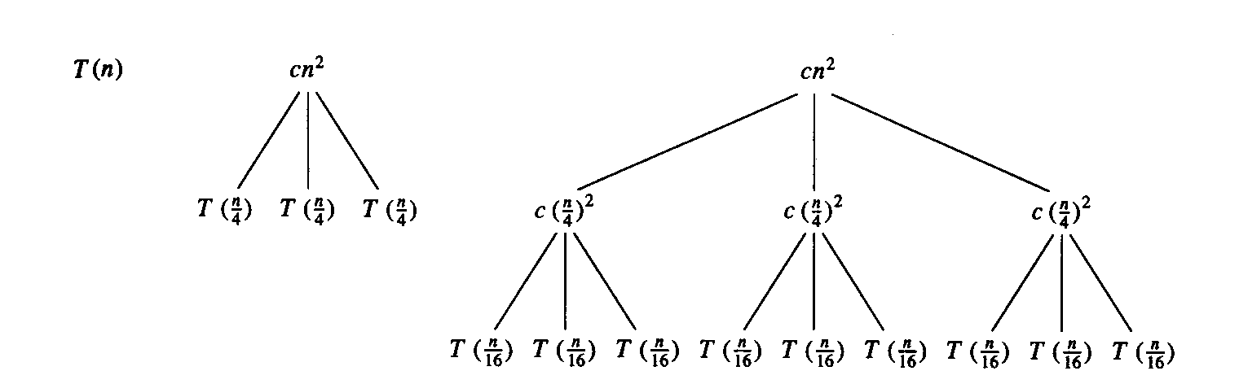
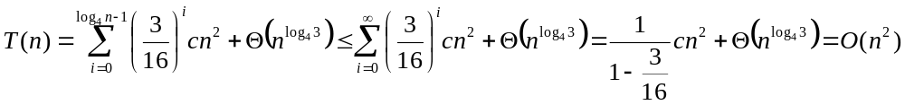
Example 2
E.g.: T(n) = 3T(n/4) + cn²
Subproblem size at level i is: n/4^{i}
Subproblem size hits 1 when 1 = n/4^{i} ⇒ i = log₄n
Cost of a node at level i = c(n/4^{i})²
Number of nodes at level i = 3^{i} ⇒ last level has 3^{log}₄^{n} = n^{log}₄³ nodes
Total cost:
⇒ T(n) = O(n²)

Slide 18
Example 2 - Substitution
T(n) = 3T(n/4) + cn²
Guess: T(n) = O(n²)
  Induction goal: T(n) ≤ dn², for some d and n ≥ n₀
  Induction hypothesis: T(n/4) ≤ d (n/4)²
Proof of induction goal:
T(n) = 3T(n/4) + cn²
≤ 3d (n/4)² + cn²
= (3/16) d n² + cn²
≤ d n² if: d ≥ (16/13)c
Therefore: T(n) = O(n²)

Slide 19
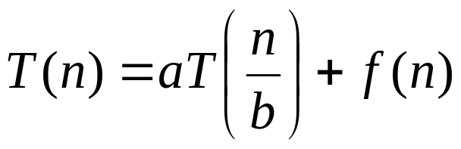
Master’s method
“Cookbook” for solving recurrences of the form:
where, a ≥ 1, b > 1, and f(n) > 0
Idea: compare f(n) with n^{log}_{b}ª
f(n) is asymptotically smaller or larger than n^{log}_{b}ª by a polynomial factor n^{ε}
f(n) is asymptotically equal with n^{log}_{b}ª

Slide 20
Master’s method
“Cookbook” for solving recurrences of the form:
where, a ≥ 1, b > 1, and f(n) > 0
Case 1: if f(n) = O(n^{log}_{b}^{a -ε}) for some ε > 0, then: T(n) = Θ(n^{log}_{b}ª)
Case 2: if f(n) = Θ(n^{log}_{b}ª), then: T(n) = Θ(n^{log}_{b}ª lgn)
Case 3: if f(n) = Ω(n^{log}_{b}^{a +ε}) for some ε > 0, and if
af(n/b) ≤ cf(n) for some c < 1 and all sufficiently large n, then:
T(n) = Θ(f(n))
regularity condition

Slide 21
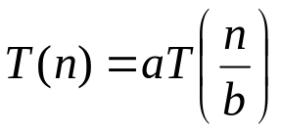
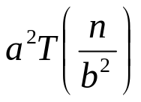
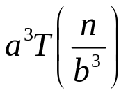
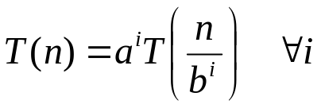
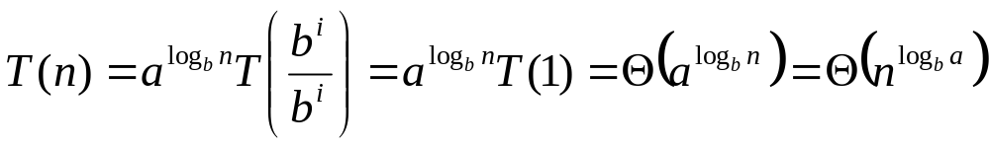
Why n^{log}_{b}ª?
Case 1:
  If f(n) is dominated by n^{log}_{b}ª:
    T(n) = Θ(n^{log}_{b}^{n})
Case 3:
  If f(n) dominates n^{log}_{b}ª:
    T(n) = Θ(f(n))
Case 2:
  If f(n) = Θ(n^{log}_{b}ª):
    T(n) = Θ(n^{log}_{b}ª logn)
Assume n = b^{k} ⇒ k = log_{b}n
At the end of iteration i = k:

Slide 22
Examples
T(n) = 2T(n/2) + n
a = 2, b = 2, log₂2 = 1
Compare n^{log}₂² with f(n) = n
⇒ f(n) = Θ(n) ⇒ Case 2
⇒ T(n) = Θ(nlgn)

Slide 23
Examples
T(n) = 2T(n/2) + n²
a = 2, b = 2, log₂2 = 1
Compare n with f(n) = n²
⇒ f(n) = Ω(n^{1+ε}) Case 3 ⇒ verify regularity cond.
a f(n/b) ≤ c f(n)
⇔ 2 n²/4 ≤ c n² ⇒ c = ½ is a solution (c<1)
⇒ T(n) = Θ(n²)

Slide 24

Examples (cont.)
T(n) = 2T(n/2) +
a = 2, b = 2, log₂2 = 1
Compare n with f(n) = n^{1/2}
⇒ f(n) = O(n^{1-ε}) Case 1
⇒ T(n) = Θ(n)

Slide 25
Examples
T(n) = 3T(n/4) + nlgn
a = 3, b = 4, log₄3 = 0.793
Compare n^{0.793} with f(n) = nlgn
f(n) = Ω(n^{log}₄^{3+ε}) Case 3
Check regularity condition:
3∗(n/4)lg(n/4) ≤ (3/4)nlgn = c ∗f(n), c=3/4
⇒T(n) = Θ(nlgn)

Slide 26
Examples
T(n) = 2T(n/2) + nlgn
a = 2, b = 2, log₂2 = 1
Compare n with f(n) = nlgn
  seems like case 3 should apply
f(n) must be polynomially larger by a factor of n^{ε}
In this case it is only larger by a factor of lgn

